Slide 1
GoToMeeting
Live Presentation: WCC
Presented by
Elizabeth Ann Nofs
Notes:
GoToMeeting
Presented by
Elizabeth Ann Nofs

Slide 2
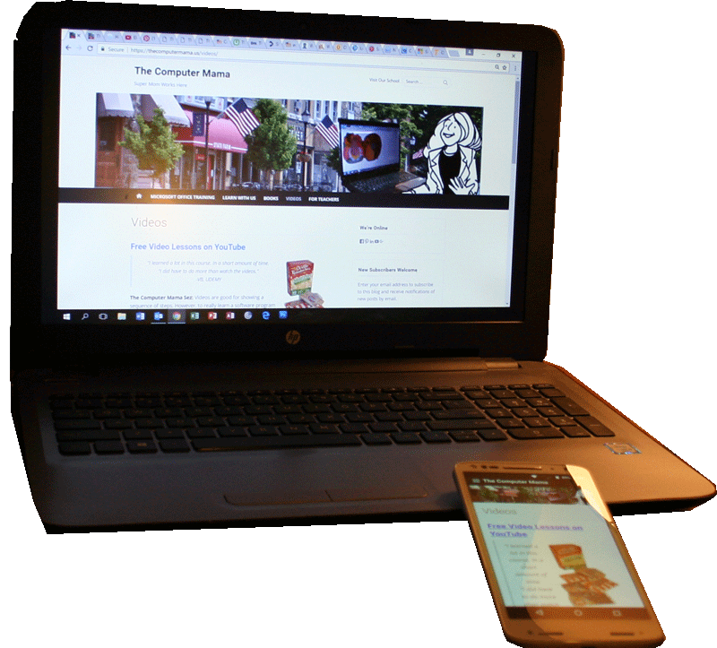
GoToMeeting
Getting Started
Hello, GoToMeeting
Create an Account
Create a Meeting
Presented March 2020
Elizabeth Ann Nofs
Notes:
Setting the Scene
Create a Practice Meeting
Review the Video and Audio
Best Practices

Slide 3
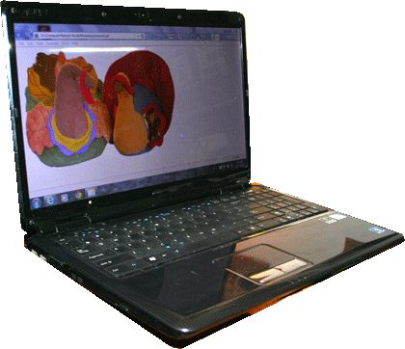
GoToMeeting by LogMeIn
Web-Hosted Conferences
Host Webinars
Schedule a Meeting
Schedule Rooms for several sessions
Invitation Links
No Login Needed
Links can be emailed or posted on a website
GoToMeeting
Reference: https://www.gotomeeting.com/
Notes:
Web-Hosted Conferences
Schedule a Meeting
Schedule Rooms for several sessions
Invitation Links
No Login Needed
Links can be emailed or posted on a website

Slide 4
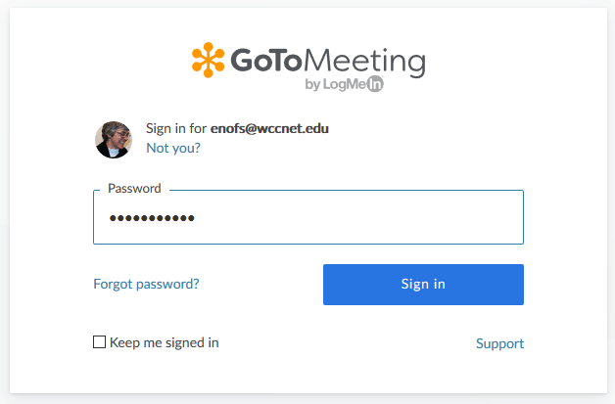
Before You Begin
Create an Account
Enter the following:
First and Last Name
Business Email
Password
Sign Into GoToMeeting
Confirm that you can sign into your account
GoToMeeting Sign In Screen
Reference: https://www.gotomeeting.com/
Notes:
Reference: https://www.gotomeeting.com/

Slide 5
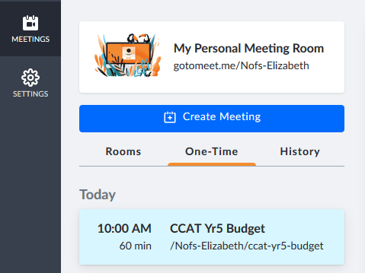
What Are Meetings?
Meeting Options
GoToMeeting can schedule:
Rooms
One-Time
Upcoming Meetings
Meetings that you scheduled will be listed by date and time. When you click on a meeting, the meeting details will be displayed on the right.
How to Navigate the GoToMeeting Website: https://youtu.be/4Uu29i4FwIU
Notes:
How to Navigate the GoToMeeting Website: https://youtu.be/4Uu29i4FwIU

Slide 6
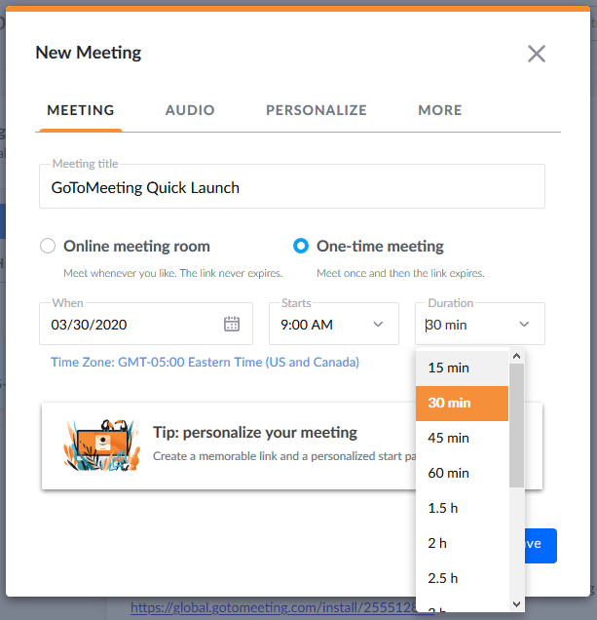
Create a New Meeting
One Time Meeting
Enter the following:
Meeting Title
Date (Date picker)
Start Time
Duration
Click Save.
NOTE: You do NOT need to require a user password for these free webinars.
GoToMeeting Organizer Training - Part 1 - Scheduling: https://youtu.be/sWhG88WQCEc
Notes:
GoToMeeting Organizer Training - Part 1 - Scheduling: https://youtu.be/sWhG88WQCEc

Slide 7
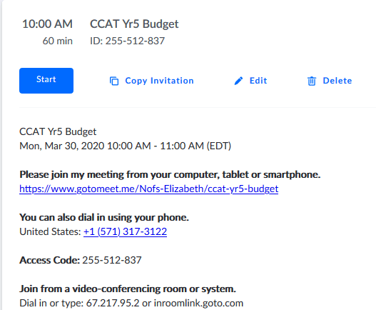
Meeting Details
Review the Meeting Details
The Meeting displays the Title, date and time.
There is a START button, which we will practice.
Edit the Meeting Details
You can update or edit the meeting invitation.
You can also delete a meeting invitation.
Reference: https://www.gotomeeting.com/
Notes:
Reference: https://www.gotomeeting.com/

Slide 8
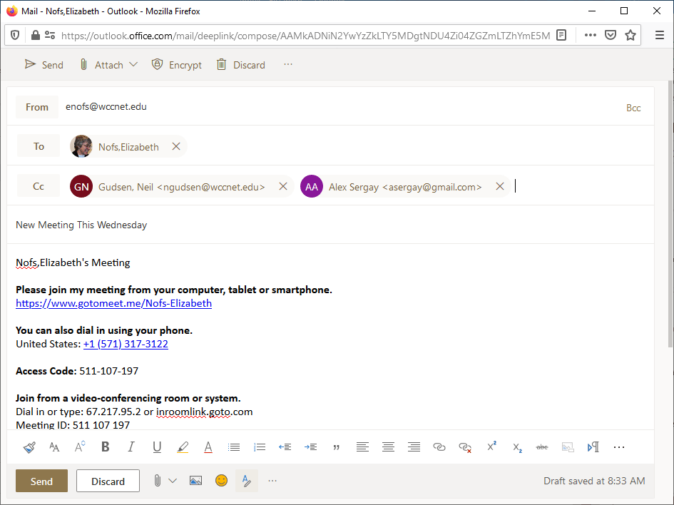
Sharing Options
Invitation to Join
The Meeting Details that you copied from GoToMeeting website can be pasted into an email, such as Outlook.
You can also post the link to a weblog, however this may not work as well.
The Meeting details includes how to join by web browser, phone, or through a business conference service.
Reference: https://www.gotomeeting.com/
Notes:
Reference: https://www.gotomeeting.com/

Slide 9
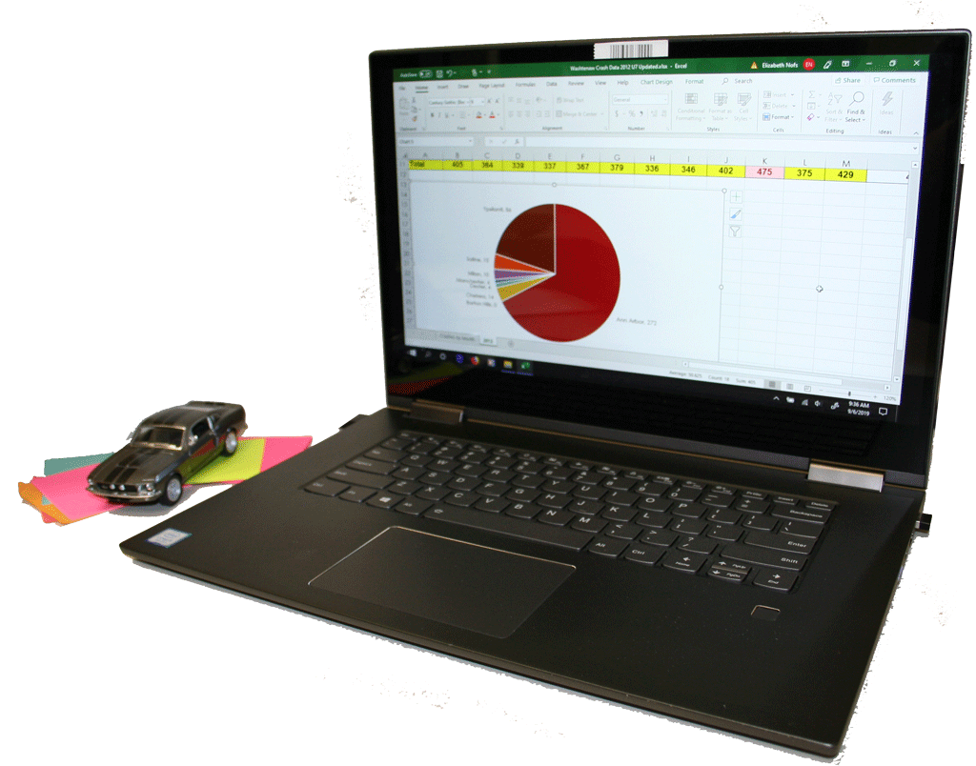
GoToMeeting
Setting the Scene
Create a Practice Meeting
Review the Video and Audio
Best Practices
Presented March 2020
Elizabeth Ann Nofs
Notes:
Setting the Scene
Create a Practice Meeting
Review the Video and Audio
Best Practices

Slide 10
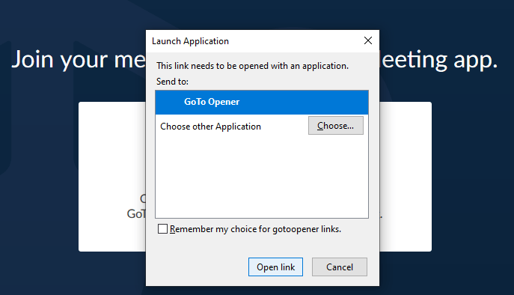
Join the Meeting
Join the Meeting
The GoToMeeting Host should join the meeting at least 10 minutes prior to the start time.
If this is your first time joining a meeting, you and all attendees will be prompted to download the GoToMeeting helper app.
Notes:
Join the Meeting
The GoToMeeting Host should join the meeting at least 10 minutes prior to the start time.
If this is your first time joining a meeting, you and all attendees will be prompted to download the GoToMeeting helper app.

Slide 11
Host a Meeting
Create a Sample Meeting
A practice meeting is a good opportunity to set the scene for the broadcast.
The purpose of the meeting is to review the camera and sound settings to get the best broadcast possible.
Please start the sample meeting to practice the following steps.
Reference: https://www.gotomeeting.com/
Notes:
Reference: https://www.gotomeeting.com/

Slide 12
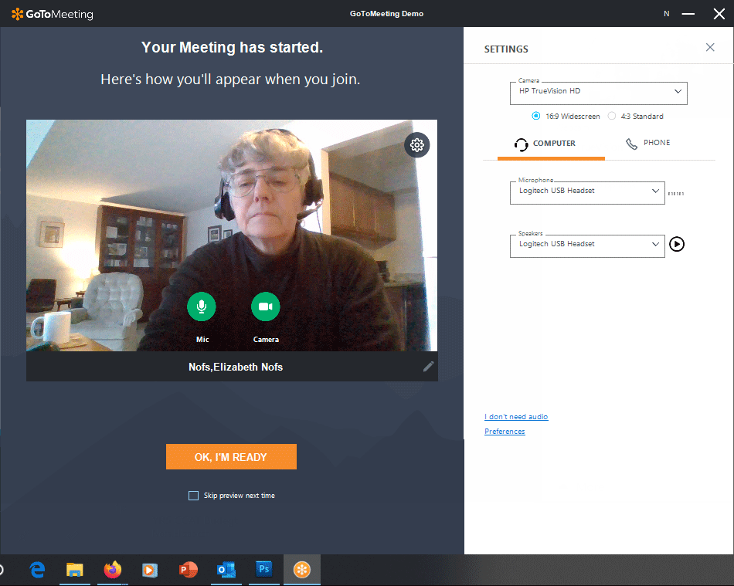
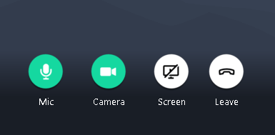
Do a Screen Test
Preview the Live Stream
Before you begin an online meeting, you can preview the camera and sound.
The live stream will preview when you turn on the camera.
Its a good time to look behind you and see if are ready for guests. Clean up any private business and political images.
GoToMeeting - Organizer Training - Part 2 - Hosting: https://youtu.be/OtgL1llP2AY
Notes:
GoToMeeting - Organizer Training - Part 2 - Hosting: https://youtu.be/OtgL1llP2AY

Slide 13
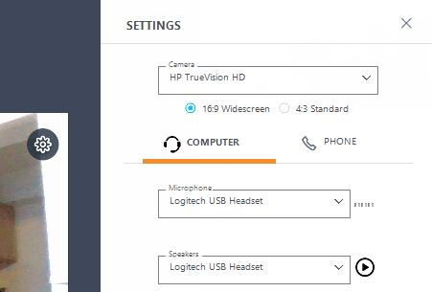
How Does it Sound?
Choose the Right Mic
If you click on the Settings gear button in the upper right corner) the pane will open.
Here you can pick a different microphone, say a headset instead of the laptop mic.
Notes:
GoToMeeting - Organizer Training - Part 2 - Hosting: https://youtu.be/OtgL1llP2AY

Slide 14
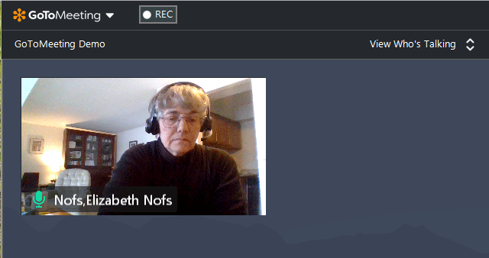
Start the Meeting
The Meeting Room
The Meeting Room shows an icon or video feed for each attendee.
The person speaking has a green mic. It’s a good clue for identifying who is talking.
All attendees can show or hide the thumbnail screens.
Getting Started with the New GoToMeeting: https://youtu.be/HKJ-Ei4z8k8
Notes:
Getting Started with the New GoToMeeting: https://youtu.be/HKJ-Ei4z8k8

Slide 15
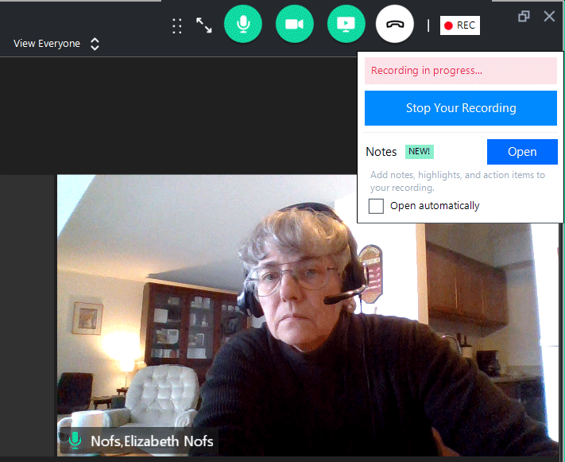
Record a Meeting
Record a Meeting
When everyone has signed in and said, hello, you can record your meeting.
When you click Record, the meeting attendees will be notified that the meeting is being recorded. There is an audible announcement and an onscreen banner.
How to Record a Meeting on GoToMeeting: https://youtu.be/IoCYVUekg1c
Notes:
How to Record a Meeting on GoToMeeting: https://youtu.be/IoCYVUekg1c

Slide 16
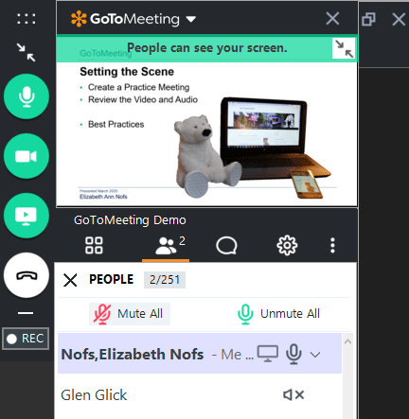
Share Your Screen
You can set up PowerPoint presentations and websites prior to your meeting.
When you are ready, you can use the Meeting Tools to Share your screen. You will be asked to select which window you want to show on screen.
Note: Close all private email and business documents before sharing your screen!
How to Screen Share on Browser with GoToMeeting Web App: https://youtu.be/6noUJjsUgIM
Notes:
How to Screen Share on Browser with GoToMeeting Web App: https://youtu.be/6noUJjsUgIM

Slide 17
Share the Sound
Note: By default, the host has the mic turned on. The rest of the attendees have their sound turned off.
For example, Glen Glick is cannot speak during the meeting. His mic is muted (x).
You can decide if some, or all of your attendees, can contribute to the discussion.
How to Screen Share on Browser with GoToMeeting Web App: https://youtu.be/6noUJjsUgIM
Notes:
How to Screen Share on Browser with GoToMeeting Web App: https://youtu.be/6noUJjsUgIM

Slide 18
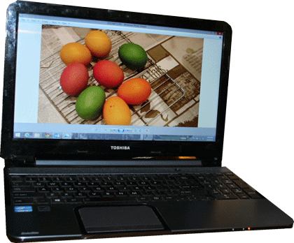
GoToMeeting
Create a Show
PowerPoint and YouTube Videos
PowerPoint and Excel
Create Videos with Camtasia
Presented March 2020
Elizabeth Ann Nofs
Notes:
Setting the Scene
Create a Practice Meeting
Review the Video and Audio
Best Practices

Slide 19
Powered Up PowerPoint®
Links and YouTube Videos
Microsoft® PowerPoint® and Multimedia
YouTube Video
Linking and Embedding
Presented March 2020
Elizabeth Ann Nofs
Notes:
Create a Show
Create videos with the PowerPoint®
Create videos with Camtasia
Record narrations in Audacity

Slide 20
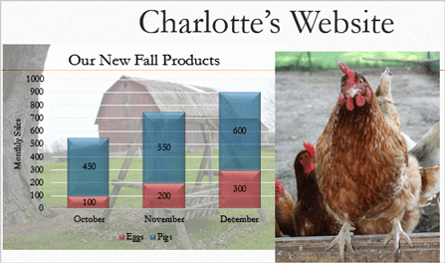
Powered Up PowerPoint®
Show the Data Visually
Integrating Microsoft® PowerPoint® and Excel
Insert and modify Charts
Using the Data
Presented March 2020
Elizabeth Ann Nofs
Notes:
Create a Show
Create videos with the PowerPoint®
Create videos with Camtasia
Record narrations in Audacity

Slide 21
Powered Up PowerPoint®
Create Videos with Camtasia
Microsoft® PowerPoint® and Camtasia
Design the presentation
Export to Camtasia
Edit in Camtasia
Presented March 2020
Elizabeth Ann Nofs
Notes:
Create a Show
Create videos with the PowerPoint®
Create videos with Camtasia
Record narrations in Audacity

Slide 22
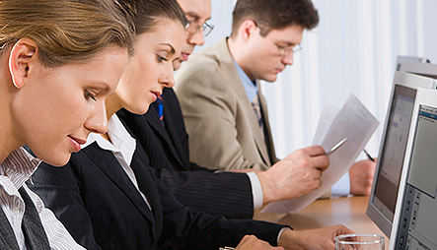
WCC Workforce Development: A complete training solution
Dynamic and Impactful Training
Our skilled instructors will inspire your people to succeed.
Contact Our Workforce Development Team ecdevelopment@wccnet.edu 734-677-5060
Notes:
Washtenaw Community College Workforce Development
Dynamic and Impactful Training
Our knowledgeable and skilled trainers will inspire your people to succeed.
Contact Our Workforce Development Team ecdevelopment@wccnet.edu 734-677-5060

